Slide 1
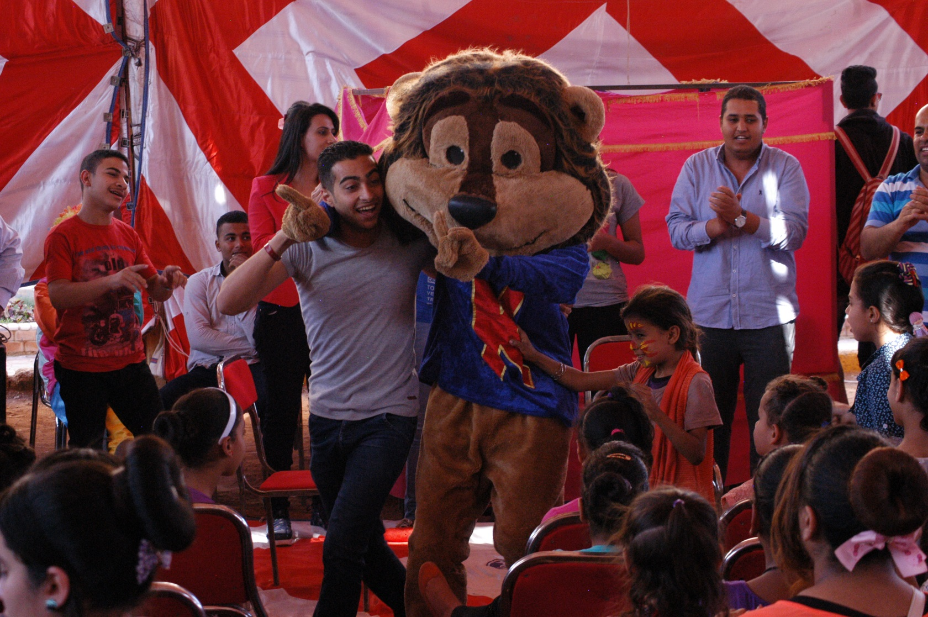
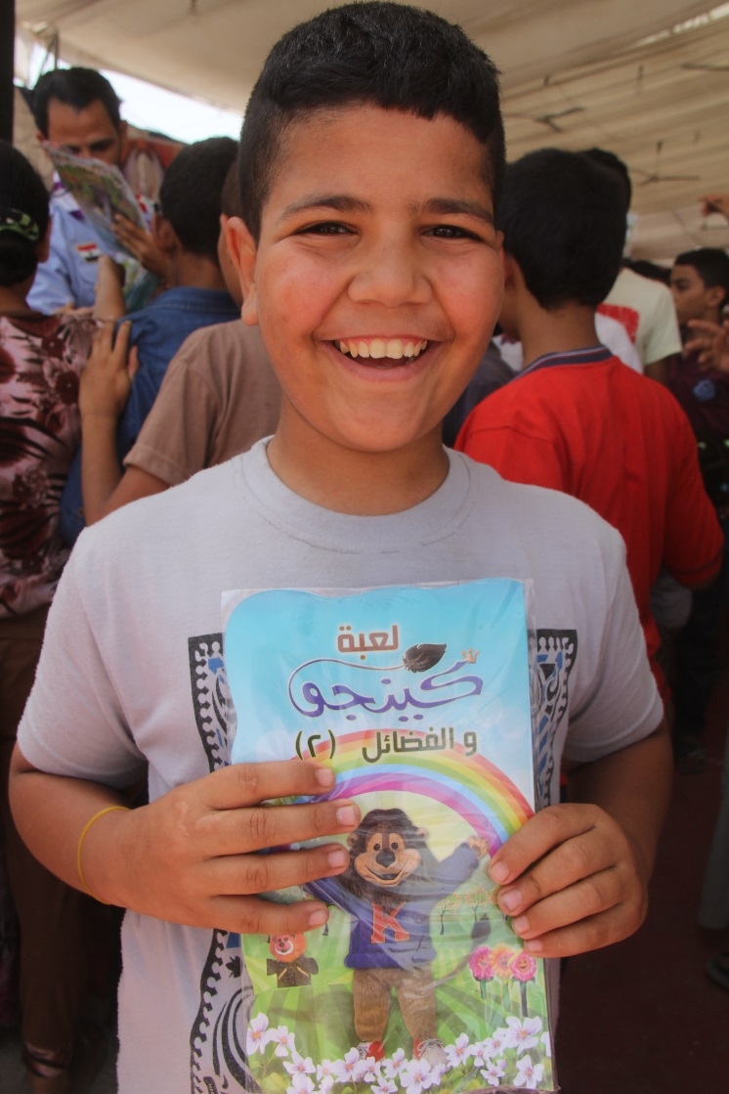
Be Brave
The Bible Society in Egypt
Kingo Festivals for Kids
be brave, speak out and share the Bible

Slide 2
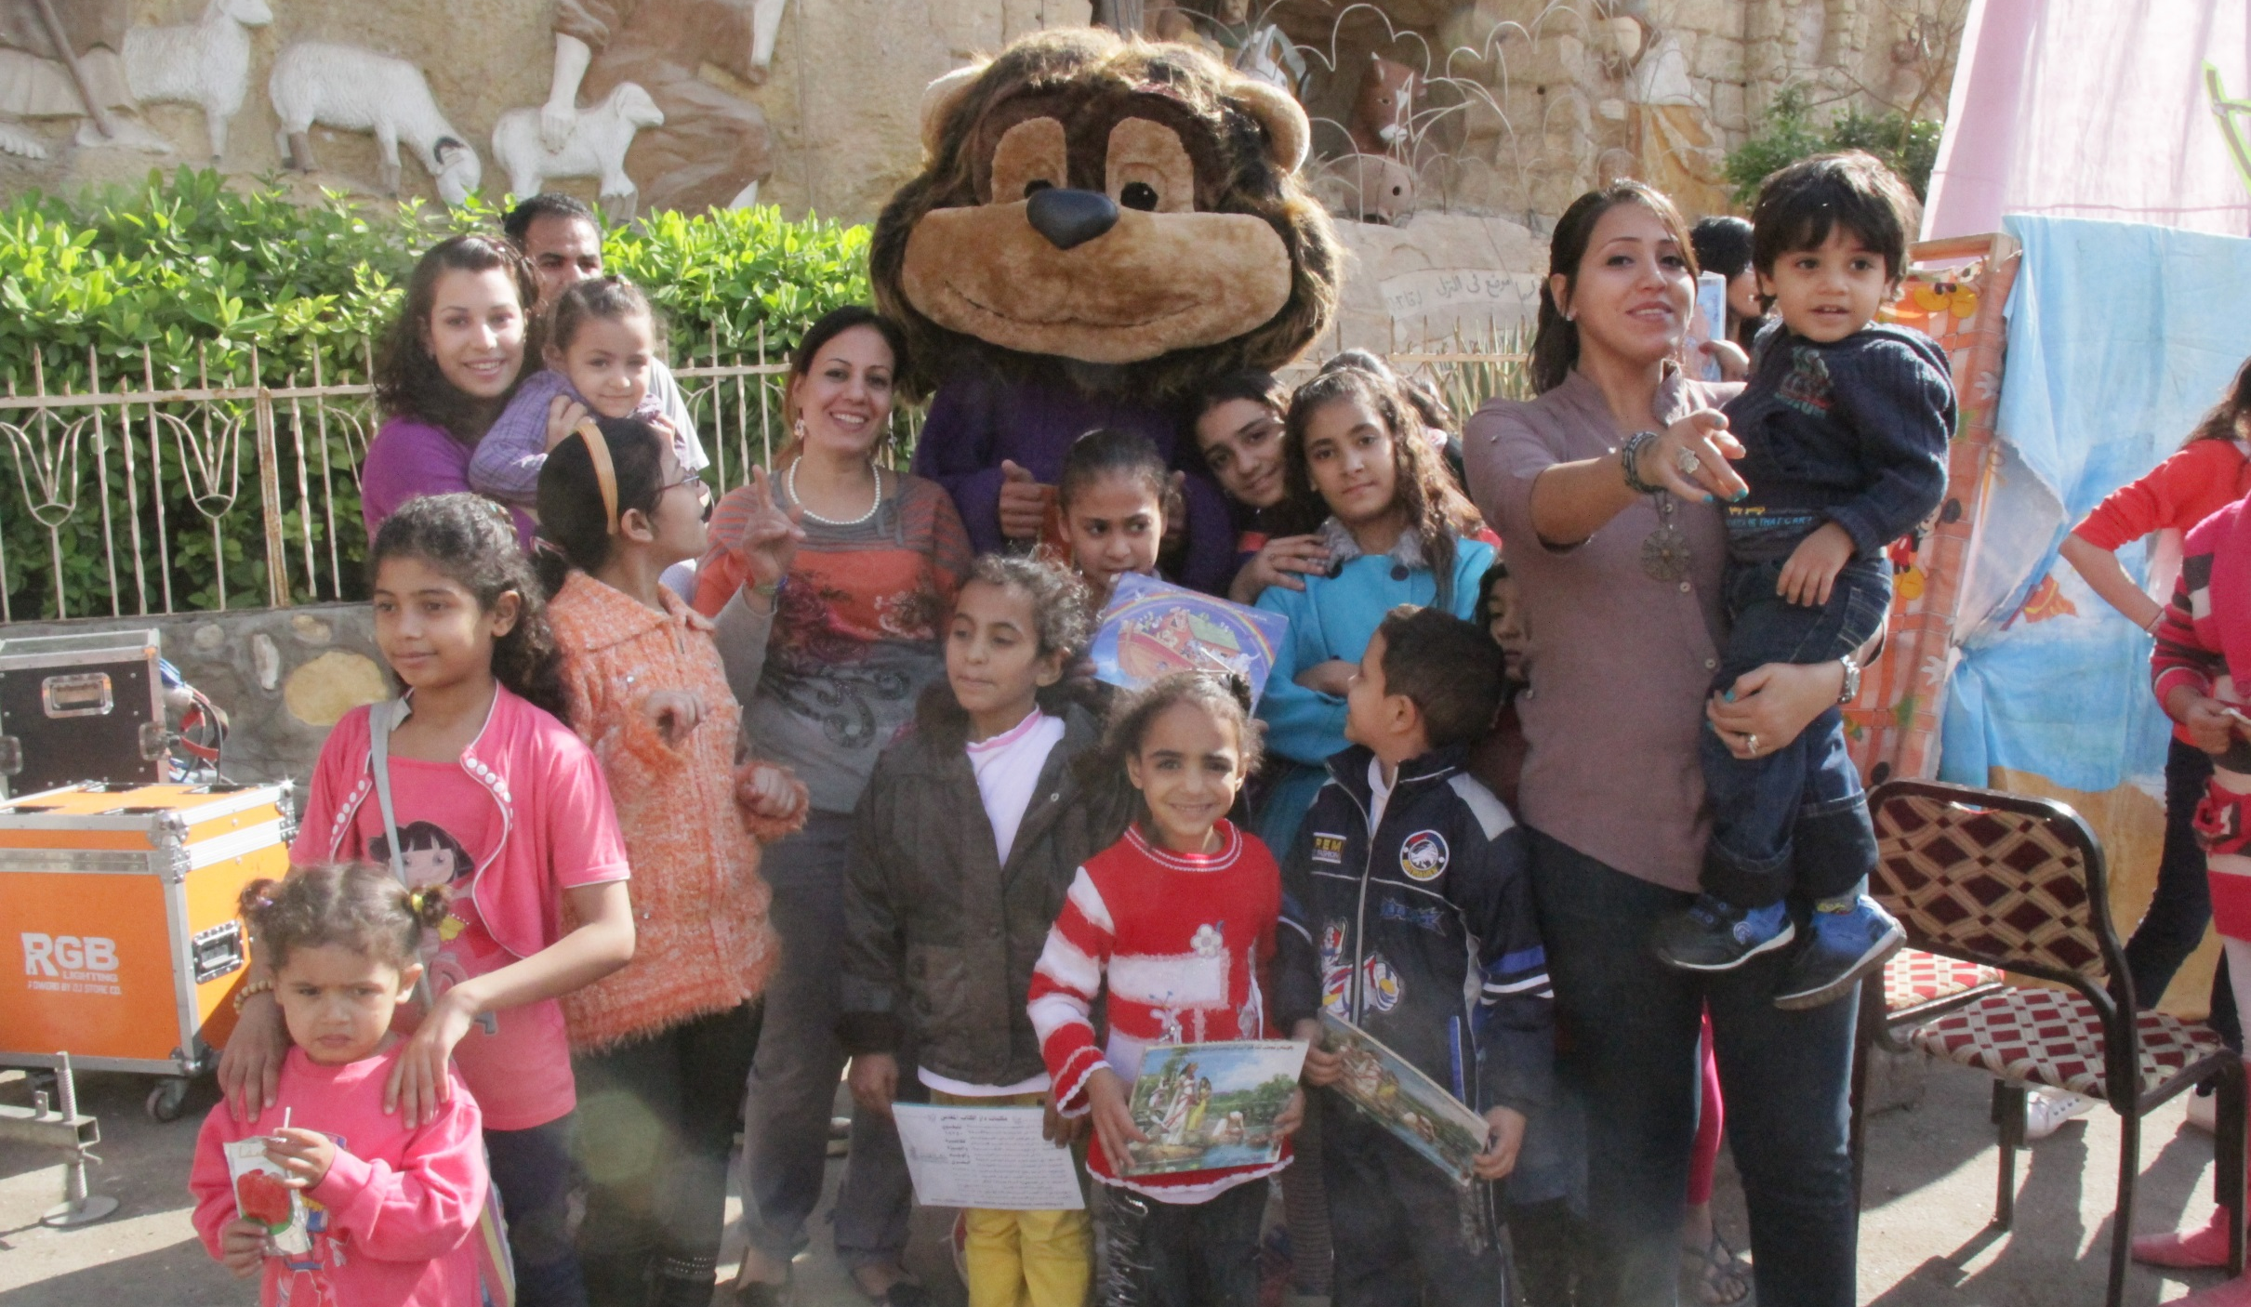
Kingo is a big friendly Bible-loving lion. Kids meet him at Kingo Festivals to learn about God.

Slide 3
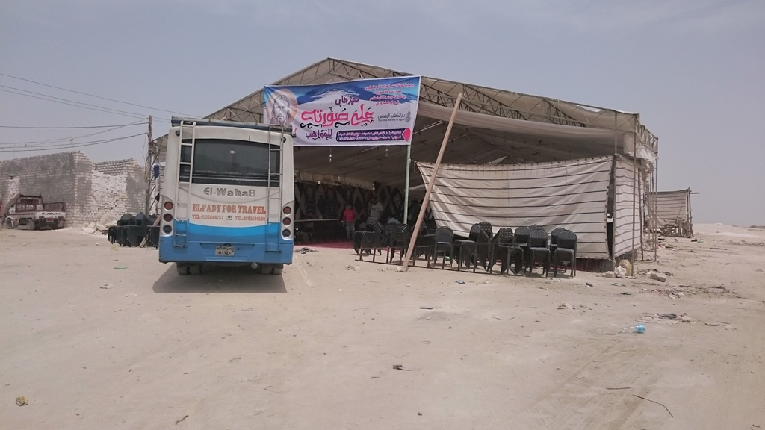
The tent is set up ready to start the Kingo Festival

Slide 4
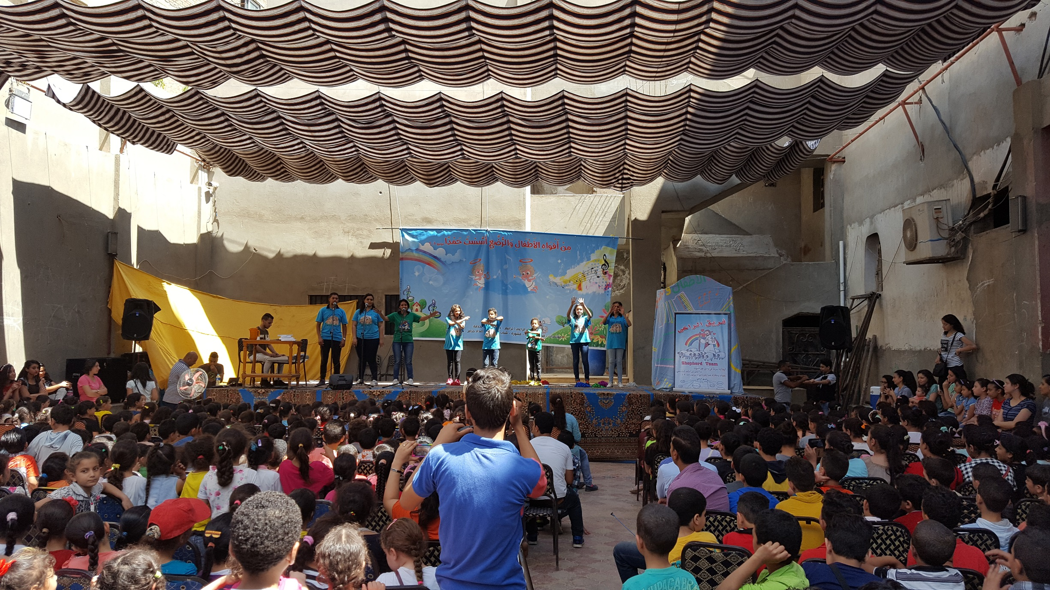
The worship team are on stage to teach the kids some new songs

Slide 5
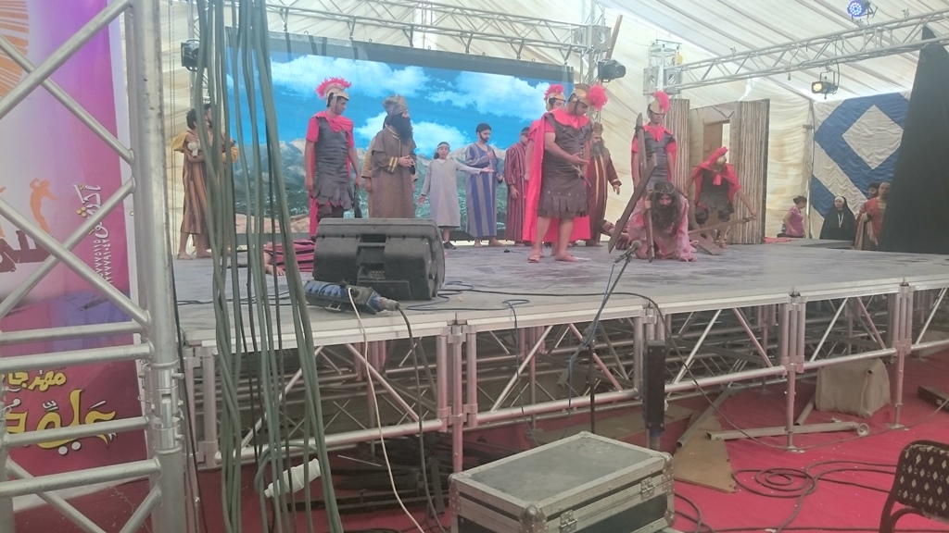
Dramas help to teach the children different Bible stories

Slide 6
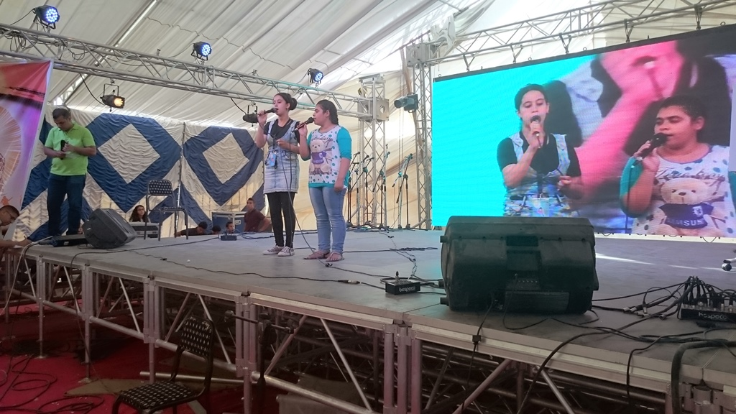
At this Festival a couple of the young people get on stage and sing a duet

Slide 7
Flags are given out to help the children remember what the Bible teaches us.

Slide 8
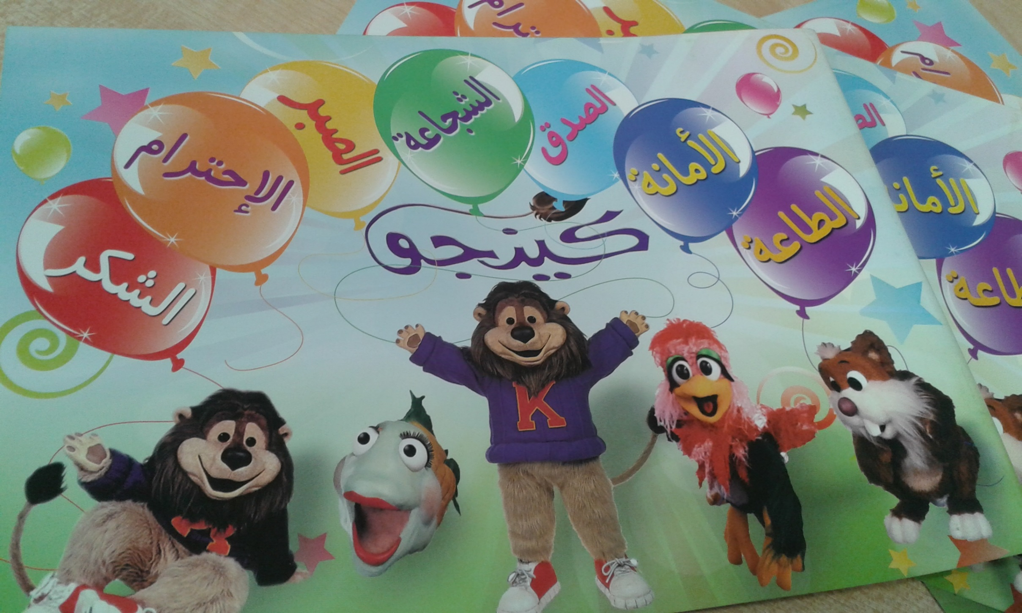
The Bible teaches us about…
Courage
Honesty
Respect
Telling the truth
Patience
Obedience
Thanksgiving

Slide 9
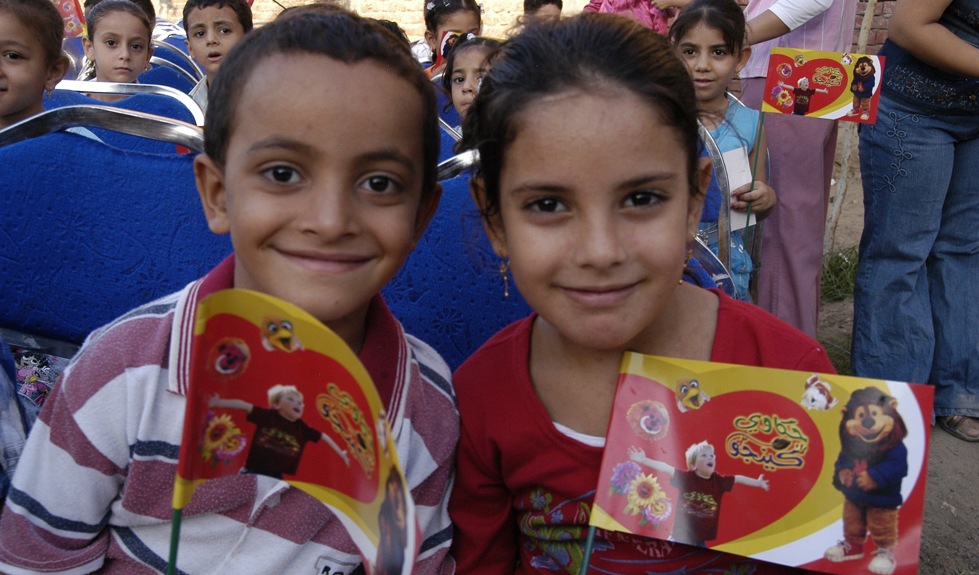
Kids wave their Kingo flags.

Slide 10
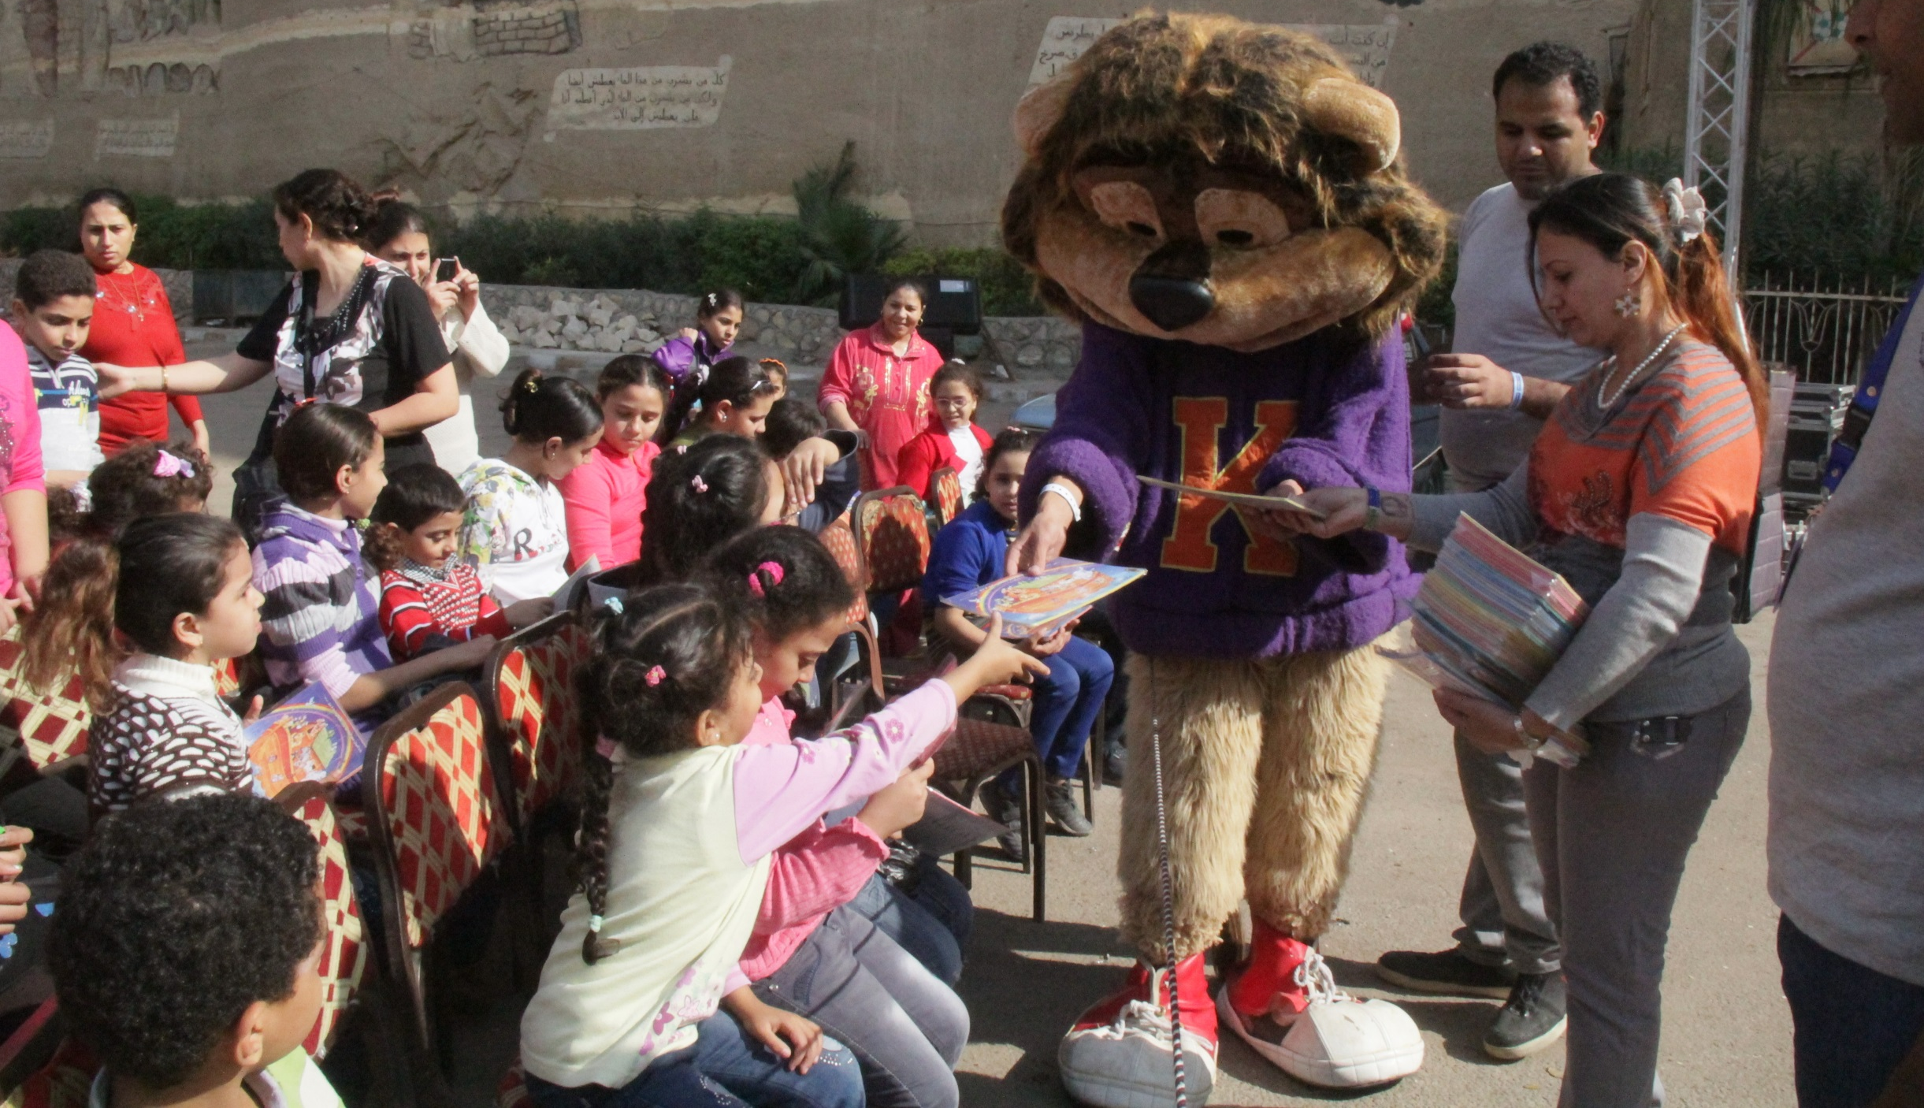
At every Festival Kingo likes to meet the kids and give them Bibles and Activity Books

Slide 11
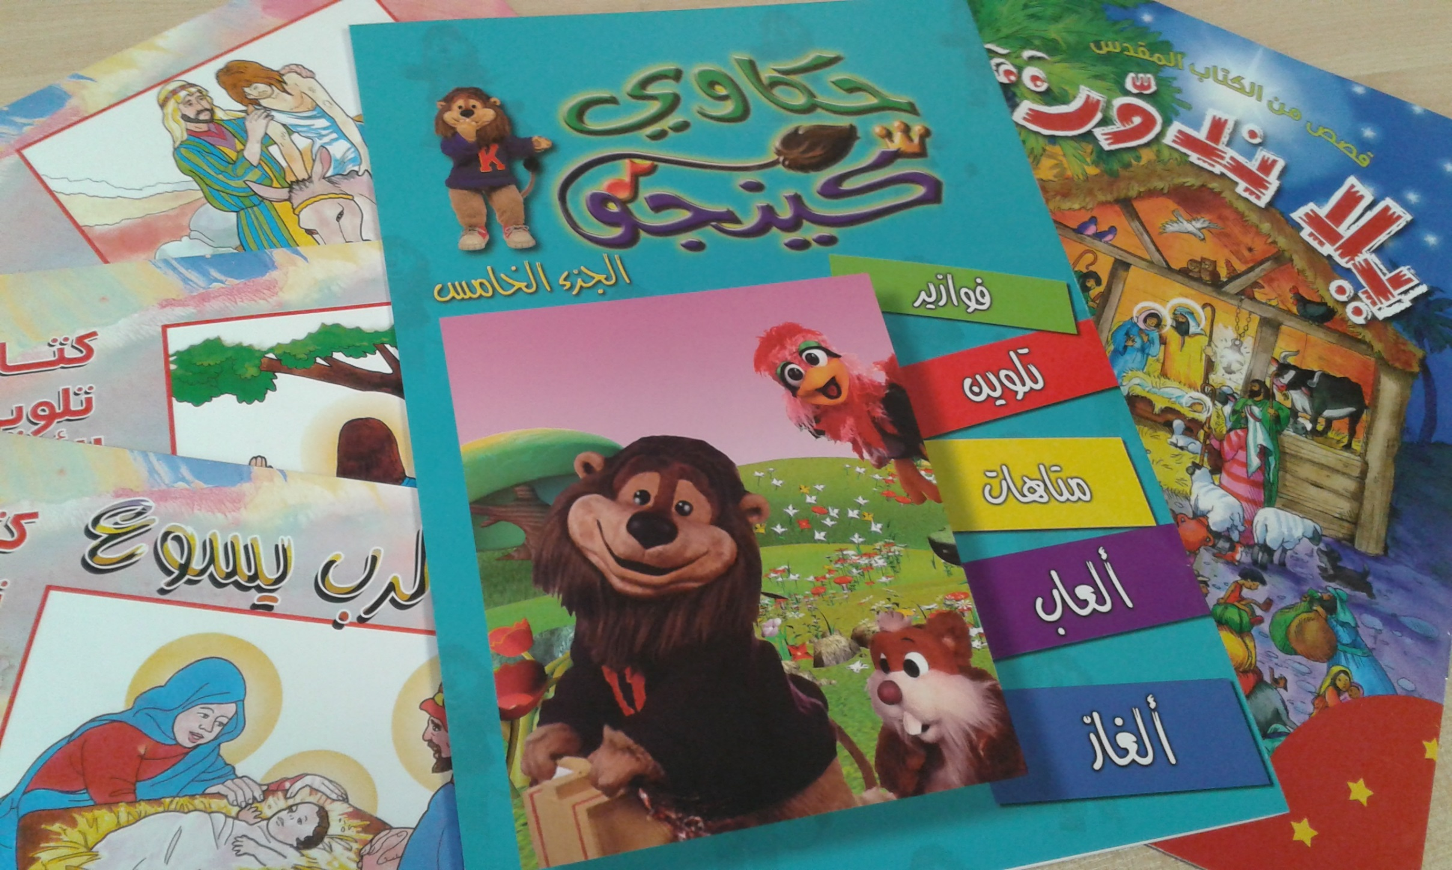
The Bible Activity Books might look like this.

Slide 12
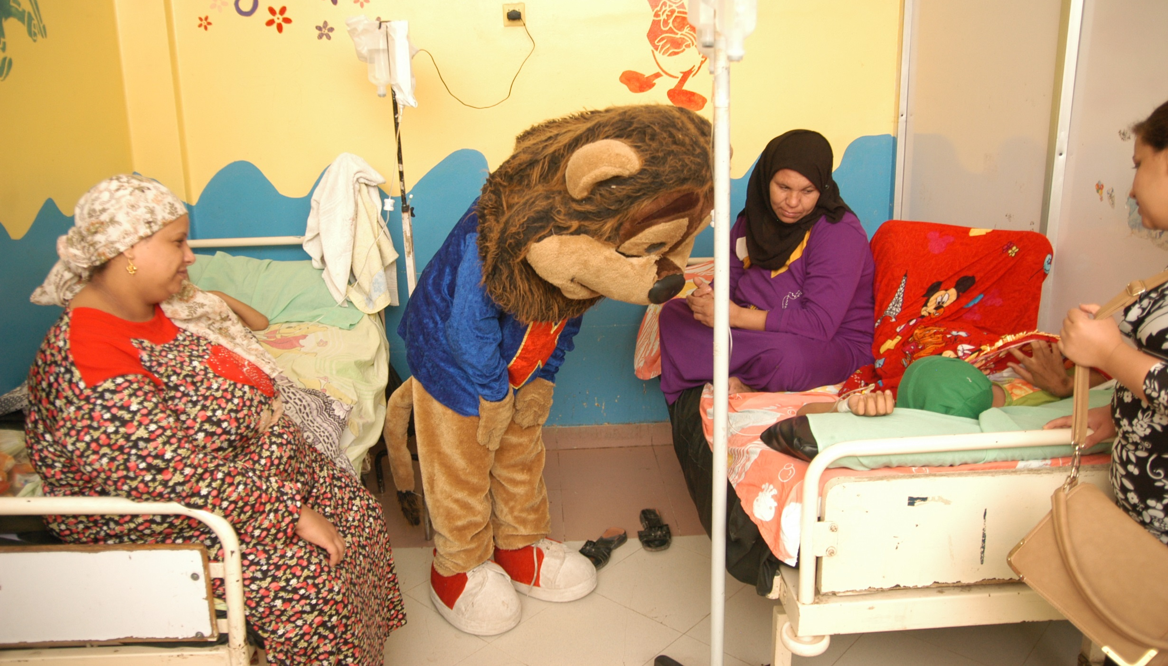
Sometimes kids can’t go to the festivals, so Kingo goes and visits them.

Slide 13
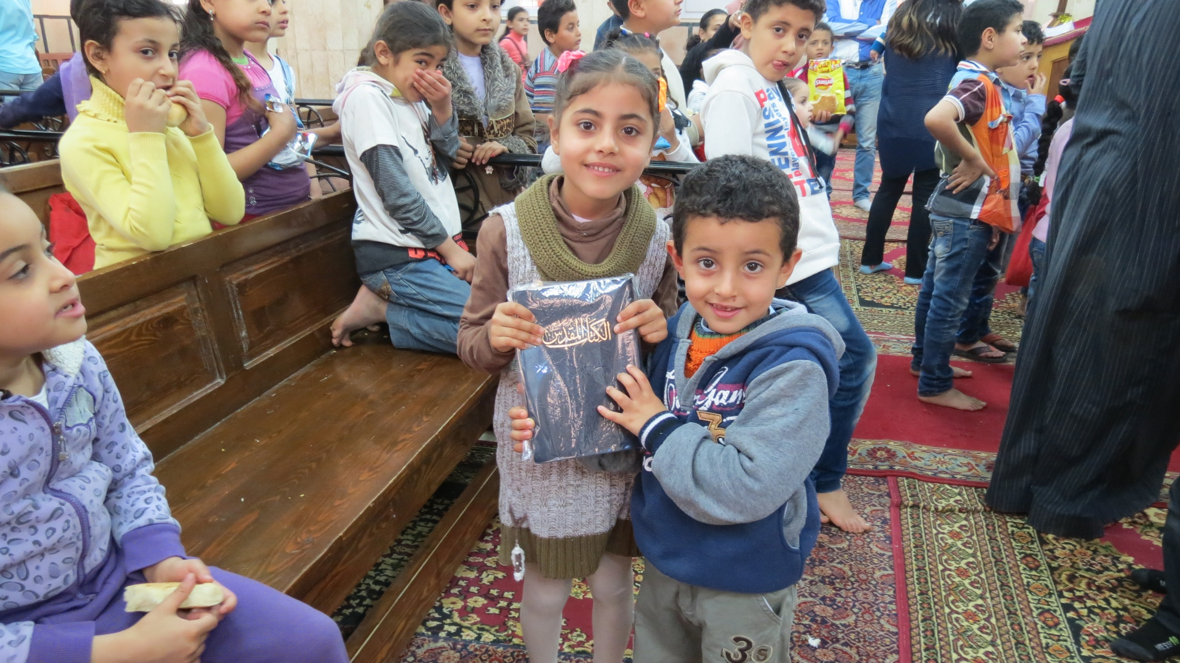
Kids are so happy to be given Bibles

Slide 14
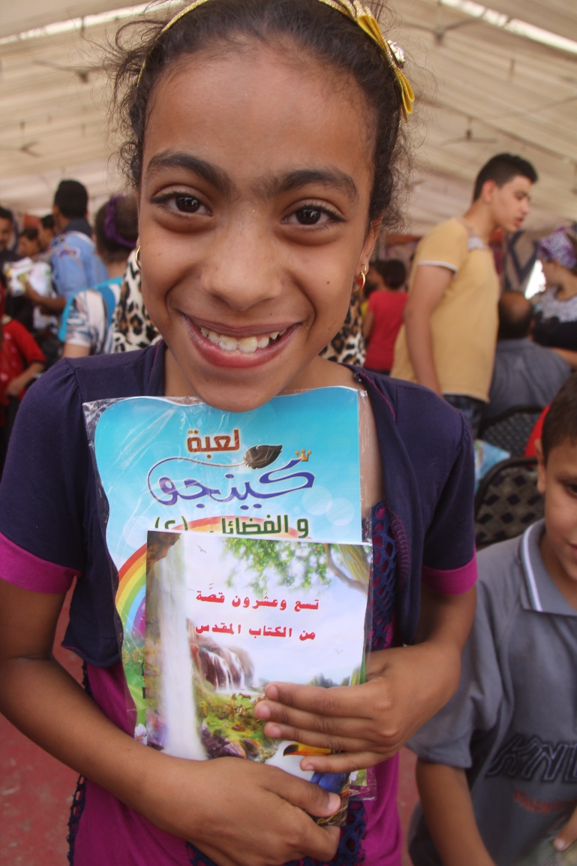
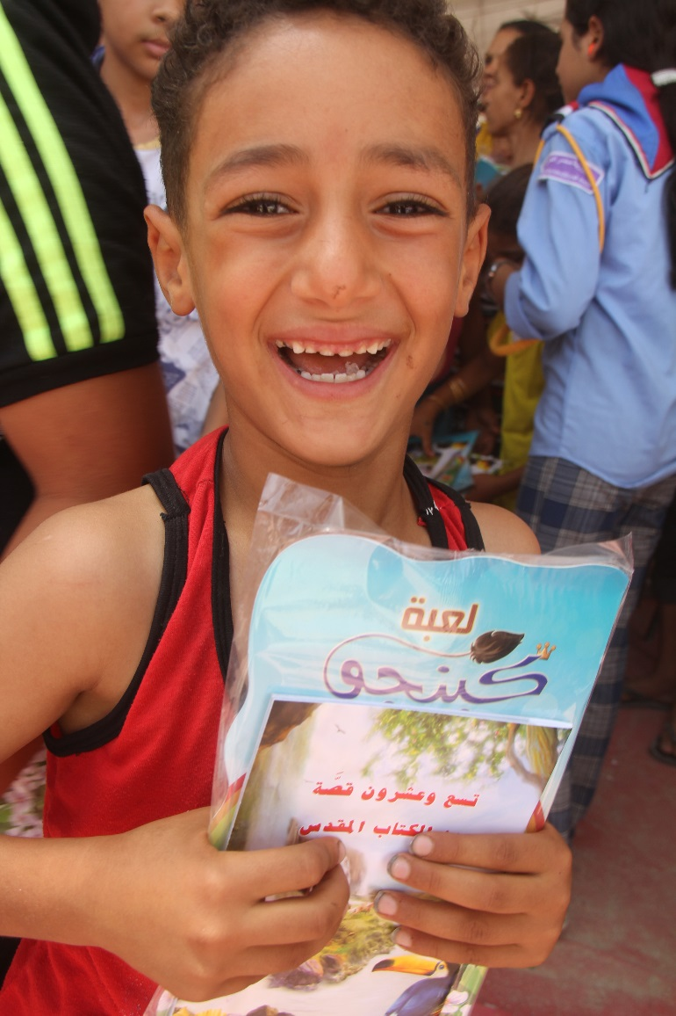
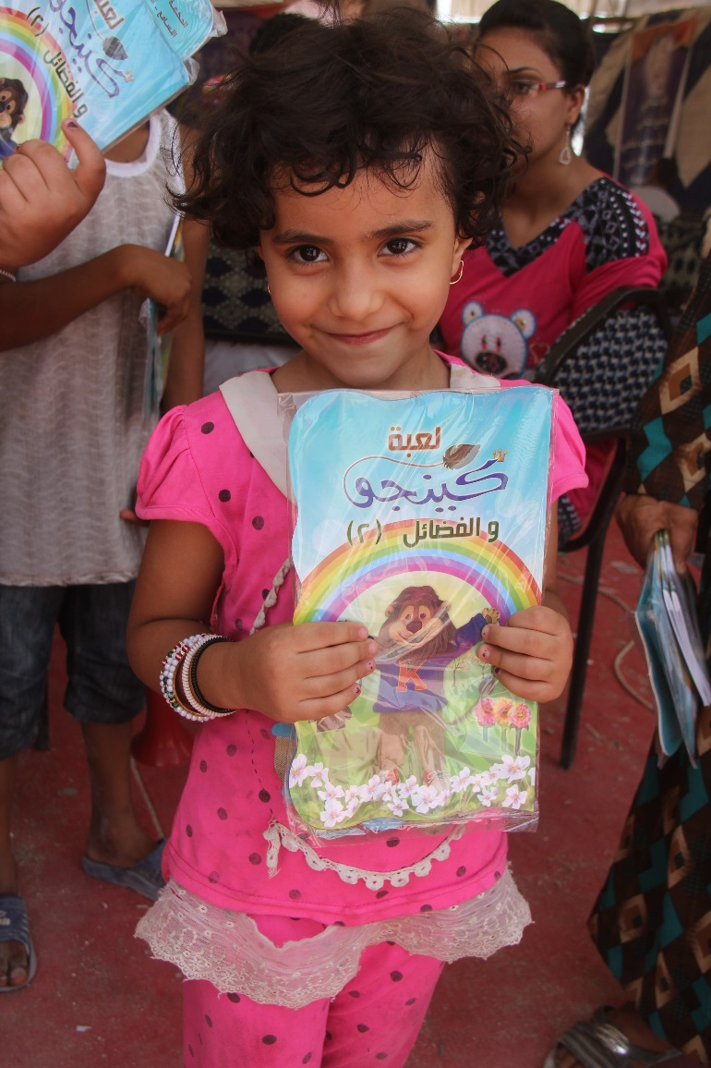
For many kids this will be the first Bible they will have owned

Slide 15
Kids like Seth have difficult lives. The Bible is really helping them.
“I am very easy to be scared, and in many villages around our village we watched very bad news about attacking the houses. In my village, the fundamentalists started to attack our houses and they started to come closer to our house, I was very, very scared because I was hearing their shouting and the screams of our neighbours and their children. I brought my illustrated Bible I received lately from my church, and I read Jesus story of calming the sea storm to my younger sister and brother, we prayed together to stop the attacking, and it happened. They did not attack our house, they stopped when we unite together in praying, Jesus still can calm the storm.”
Name and photo changed to protect child’s identity

Slide 16
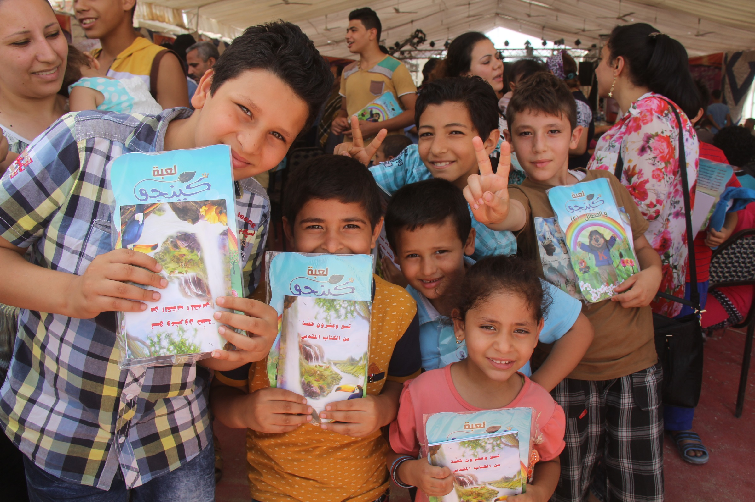
It only costs 20p to give a kid in Egypt a Bible Activity Book. Will you help?

Slide 17
Bible Society NI:
Reaching Everyone with God’s Word
Bible Society in Northern Ireland
27 Howard Street
Belfast
BT1 6NB
info@bsni.co.uk
028 9032 6577
www.bsni.co.uk
Charity Reg. no. NIC102557

